Slide 1
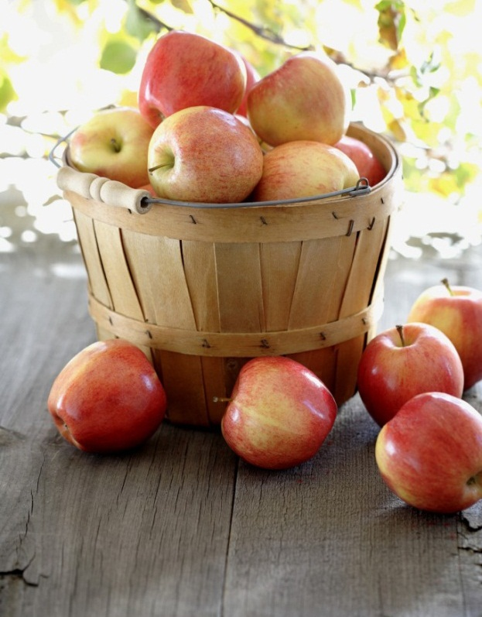
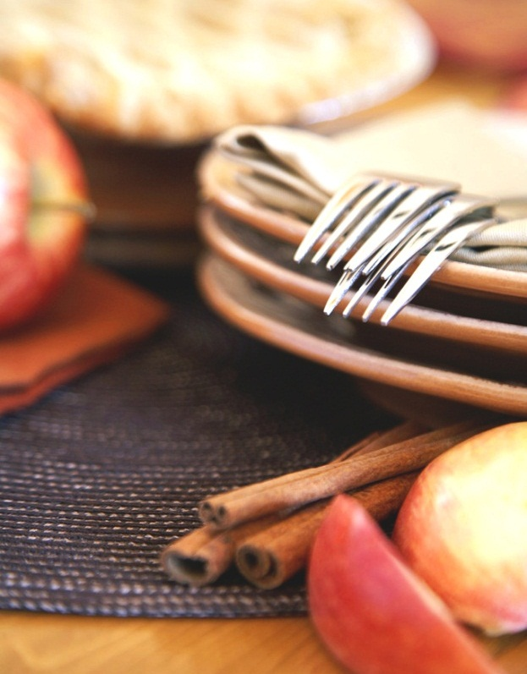
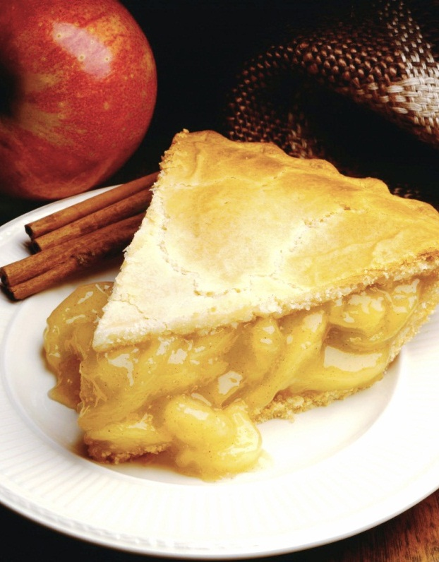
Food Recommender Based on Taste
Ranggajaya Ciptawan
Notes:
NOTE: To replace a picture, just select and delete it. Then use the Insert Picture icon to replace it with one of your own!

Slide 2
Contents
Introduction
What did I do?
What dataset did I use?
How did I classify the food taste?
How did it recommend the food?
How did I deploy the food recommender?
What are this recommender’s weaknesses?

Slide 3
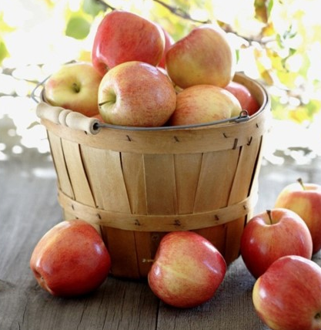
Introduction

Slide 4

Introduction
Currently, there are so many applications that can show you many choices of food.
You can also filter the food based on its type (ex. Snacks, Chinese Food, Western Food, etc.).
Furthermore, you can ask the restaurant to deliver it to your currently location!

Slide 5
Introduction
Sometimes, have you ever felt that you want to eat something but you don’t know what to eat specifically?
Something like “I want to eat spicy food!” or “I want to eat something sweet!”.
Until now, I haven’t found any application that can provide such a thing.

Slide 6
Introduction
Since I’m also a food lover, this motivates me to create something that can give me food recommendations based on my currently taste preference.
So in this slide, I’d like to share what I made and also how I made it.
I’m going to explain it a little bit detail so that you can understand what I made and then you can give me any feedback to improve it since I’m also still learning it.
But don’t worry! I’m going to explain it in a fun way. ☺

Slide 7
What did I do?

Slide 8
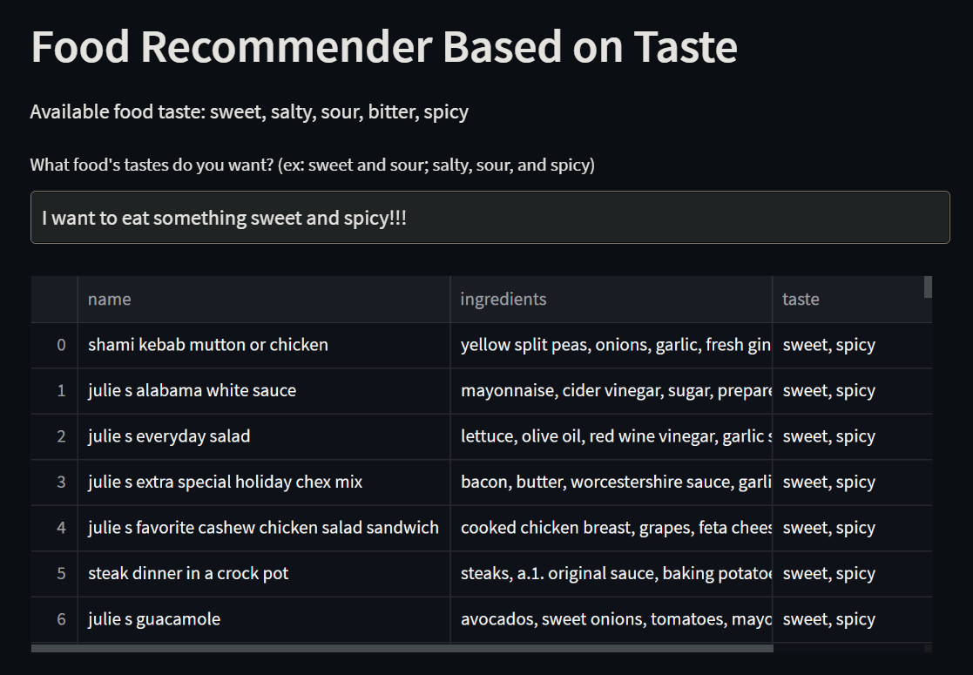
What did I do?
So, what did I do?
Well, like I said earlier, I tried to make a food recommender based on user’s currently taste preference.
You can see the example on this figure on the right.

Slide 9
What did I do?
As you can see, you can tell the system what kind of food taste you want to eat.
Then, the system will give you some food recommendations along with its ingredients.
It’s very simple, isn’t it? XD

Slide 10
What did I do?
The problem is, the dataset I got didn’t provide the food’s taste (I’ll explain about the dataset on the next section).
So, the most challenging part is “how can I classify the food taste without any deep knowledge about culinary? I’m not a chef! I don’t even know how to boil water!”
We’ll answer that question later. ☺

Slide 11
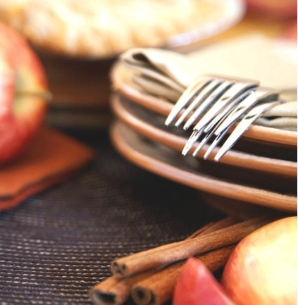
What dataset did I use?

Slide 12

What dataset did I use?
I used a dataset found on Kaggle. Here is the link.
This dataset is crawled from Food.com.
Food.com is a website that provides huge amount of food recipes. People can add their recipes and other people can comment and rate the recipes.
Actually, the foods are already classified into several types (ex. Breakfast, Brunch, Healthy Food, etc.), but not its taste.
It’s a good website so I recommend you to visit it. ☺

Slide 13
What dataset did I use?
Did I use all of the data? Of course not! I only used Raw_recipes.csv.
Did I use all of the columns? Of course not! I only used two columns, name and ingredients. I wanted to use steps, but the data became too big to be saved on Github. So just leave it be.
name: food’s name.
ingredients: food’s ingredients.
Here is the sample looks of the dataset.

Slide 14
What dataset did I use?
name | ingredients
arriba baked winter squash mexican style | ['winter squash', 'mexican seasoning', 'mixed spice', 'honey', 'butter', 'olive oil', 'salt']
a bit different breakfast pizza | ['prepared pizza crust', 'sausage patty', 'eggs', 'milk', 'salt and pepper', 'cheese']
apple a day milk shake | ['milk', 'vanilla ice cream', 'frozen apple juice concentrate', 'apple']
… | …

Slide 15
How did I classify the food taste?

Slide 16
How did I classify the food taste?
Now this is what we’ve been waiting for.
After seeing the raw dataset, you must have wondered “how do we know if this food is sweet or spicy? ”.
The most obvious answer is of course by checking the ingredients! That’s why I chose that column.
I’m sure you will answer “yeah I know. But how precisely?”.

Slide 17
How did I classify the food taste?
There were three possible ways that crossed my mind before.
First, asking the food expert, such as chef, food nutritionist, etc. Then, we can classify the food taste manually or automatically. That’s what we call expert system.
Second, we can depend on our instinct to classify the food taste. For example, the “a bit different breakfast pizza” in the dataset sample before might be salty and spicy since it uses salt, pepper, and cheese.
Third, we can use semi-supervised learning* and this is what I used. ☺
*notes: I don’t know if this method is categorize as semi-supervised learning. You can verify it after reading my method.

Slide 18
How did I classify the food taste?
So, the idea is, we will classify some of the foods first, and then training a model with those data to classify the other foods.
One of the dumbest way to classify the food is by its title. XD
For example, “windy’s sweet and sour meatballs” will be classified as sweet and sour food.
Let’s just assume that the food’s taste is guaranteed by its title. ☺

Slide 19
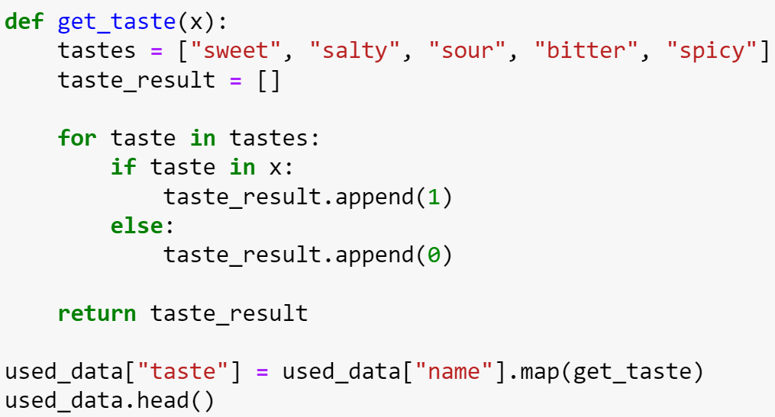
How did I classify the food taste?
We will express the food taste with a binary vector.
For example, sweet and sour will be expressed as [1 0 1 0 0], salty and spicy will be expressed as [0 1 0 0 1], etc.
The get_taste function will do the job. It will be implemented to all rows.

Slide 20
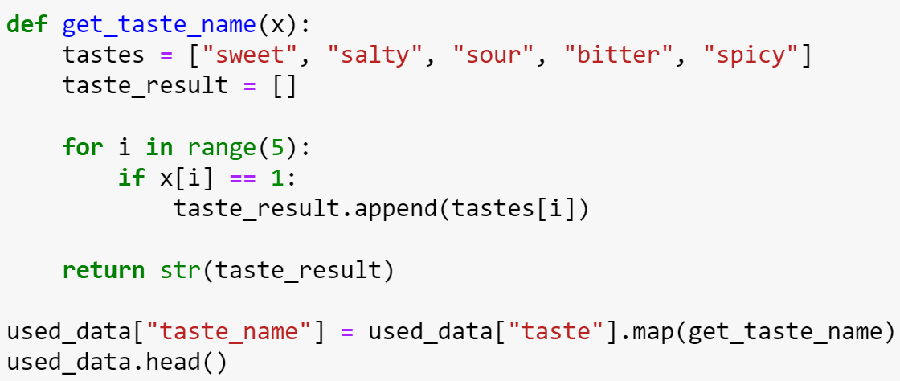
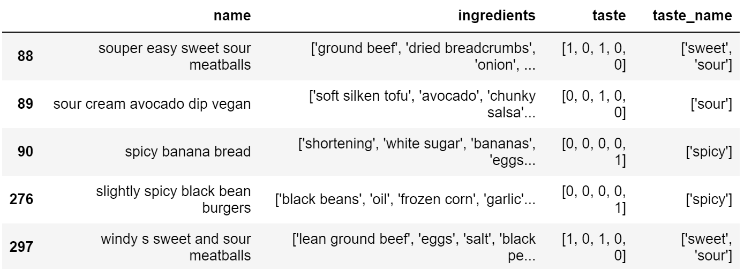
How did I classify the food taste?
To make it more readable, we will convert the vector into the taste’s name.
The result will look like the bottom right figure.

Slide 21
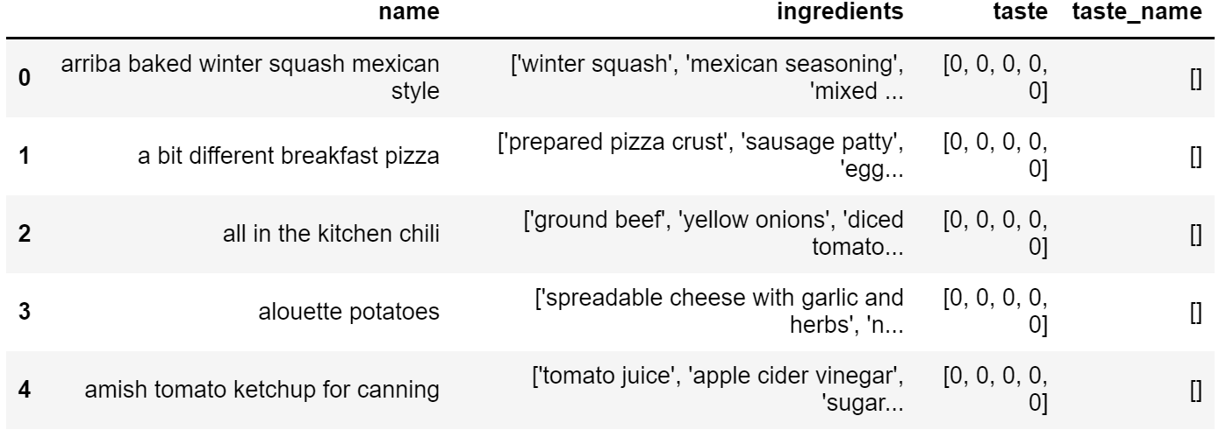
How did I classify the food taste?
Are we finished? Of course not!
As you can see on the right figure, some of the foods are not yet labeled.
That’s because not all foods are titled with its taste.

Slide 22
How did I classify the food taste?
So, what should we do then? Can we just drop the unlabeled foods?
Nope, that’s not interesting at all!
Search engine must have a big database.
How can we recommend to the user if we only have a few foods?

Slide 23
How did I classify the food taste?
Since we now have a labeled data, we can train a model to label the unlabeled data.
What algorithm will we use? Random forest? SVM?
Remember though, this is some kind of multiclass classification. We will classify the food not only to one taste, but might be more than one taste (ex. sweet and spicy, sweet and sour, etc.).
Besides, we only have food ingredients as the feature. We must convert all of the ingredients into dummy variable, then we can use those algorithms. But, there are so many food ingredients out there! Isn’t it going to be sparse?
So, I don’t now if we can use those algorithms directly.

Slide 24
How did I classify the food taste?
This is when probability theory comes in.
I don’t know whether it’s actually a known algorithm, but here’s the idea.
We will identify the taste of each unique ingredients.
We will not classify them into a specific taste, but rather calculate how strong the ingredients will give the taste.
For example, how sweet/salty/sour/bitter/spicy is “winter squash”? Is it very sweet or not so spicy?
Still don’t get it? Don’t worry, I’ll show you a more concrete example later.

Slide 25
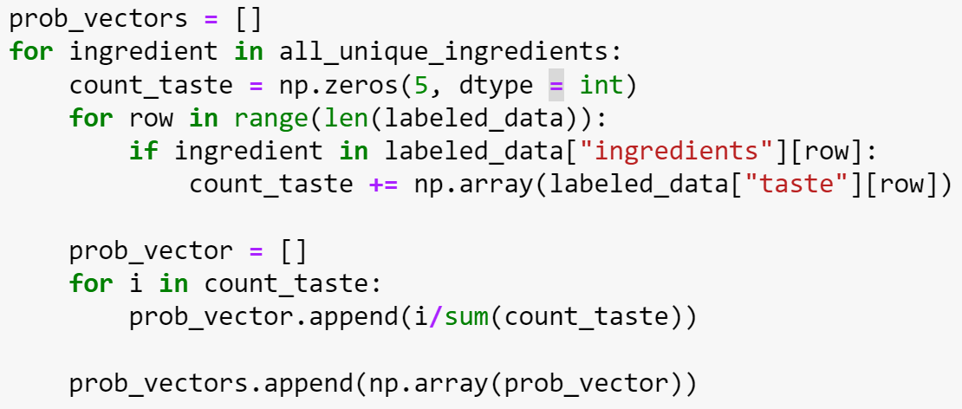
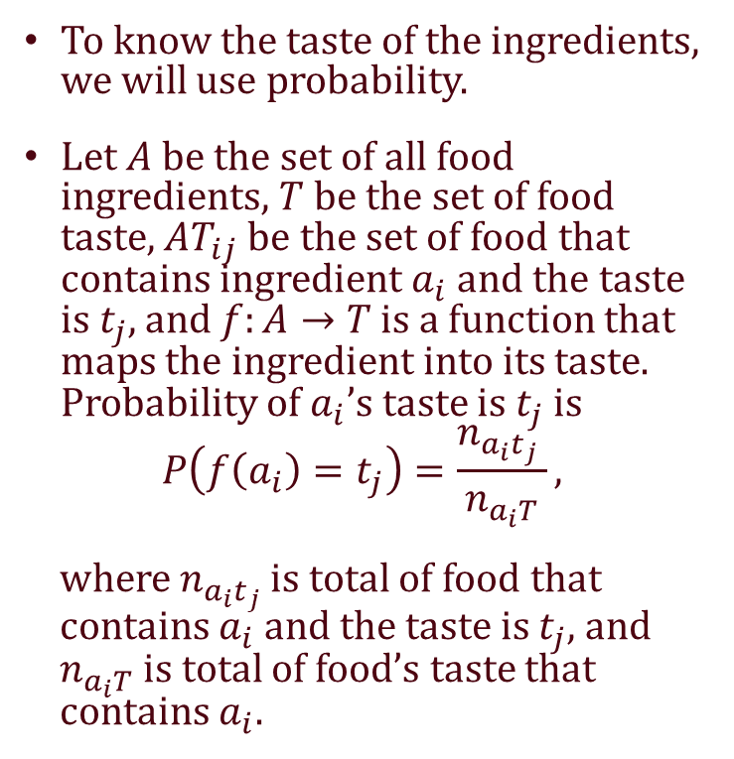
How to classify food taste?
To know the taste of the ingredients, we will use probability.
Let $A$ be the set of all food ingredients, $T$ be the set of food taste, $AT_{ij}$ be the set of food that contains ingredient $a_{i}$ and the taste is $t_{j}$, and $f:A→T$ is a function that maps the ingredient into its taste. Probability of $a_{i}$’s taste is $t_{j}$ is
$$P\left(f\left(a_{i}\right)=t_{j}\right)=\frac{n_{a_{i}t_{j}} }{n_{a_{i}T}},$$
where $n_{a_{i}t_{j}}$ is total of food that contains $a_{i}$ and the taste is $t_{j}$, and $n_{a_{i}T}$ is total of food’s taste that contains $a_{i}$.

Slide 26
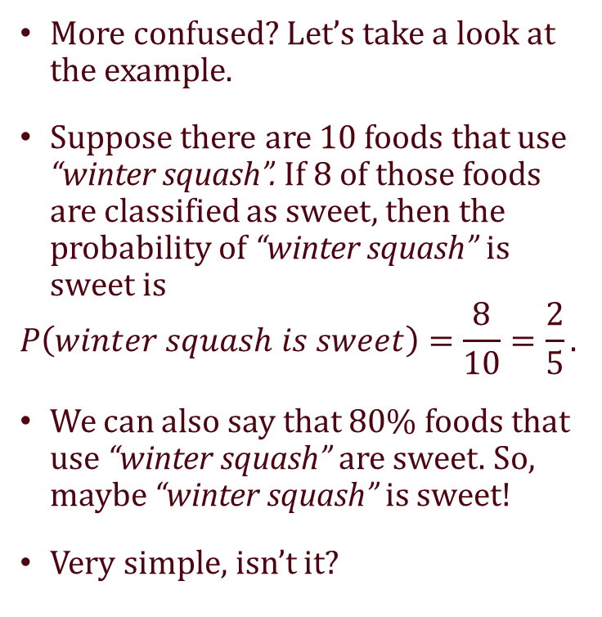
How to classify food taste?
More confused? Let’s take a look at the example.
Suppose there are 10 foods that use “winter squash”. If 8 of those foods are classified as sweet, then the probability of “winter squash” is sweet is
$$P\left(winter squash is sweet\right)=\frac{8}{10}=\frac{2}{5}.$$
We can also say that 80% foods that use “winter squash” are sweet. So, maybe “winter squash” is sweet!
Very simple, isn’t it?

Slide 27
How to classify food taste?
We will also check for other taste, i.e. we will calculate probability of “winter squash” is salty, probability of “winter squash” is sour, etc.
Then, we can express each ingredients into a vector.
For example, the vector representation of “winter squash” is [0.8, 0, 0.2, 0, 0].
That means, “winter squash” might be 80% sweet and 20% sour.

Slide 28

How to classify food taste?
After we get the vector representation of each ingredients, we will sum them all for each unlabeled foods.
Then, we check if the total portion of the taste is more than $\frac{1}{5}$ or $0.2$, then we will classify the food as that taste.
Confused? Look at the table below.
food | ingredients | sweet | salty | sour | bitter | spicy
Apple a Day Milk Shake | Milk | 0.9 | 0.1 | 0 | 0 | 0
 | Vanilla | 0.2 | 0.3 | 0.5 | 0 | 0
 | Apple | 0.6 | 0 | 0.4 | 0 | 0
Sum |  | 1.7 | 0.4 | 0.9 | 0 | 0

Slide 29

How to classify food taste?
Ratio of sweet = $\frac{1.7}{1.7+0.4+0.9+0+0}=\frac{1.7}{3}=0.567$.
Ratio of salty = $\frac{0.4}{1.7+0.4+0.9+0+0}=\frac{0.4}{3}=0.133$.
Ratio of sour = $\frac{0.9}{1.7+0.4+0.9+0+0}=\frac{0.9}{3}=0.3$.
Ratio of bitter = Ratio of spicy = $0$.
food | ingredients | sweet | salty | sour | bitter | spicy
Apple a Day Milk Shake | Milk | 0.9 | 0.1 | 0 | 0 | 0
 | Vanilla | 0.2 | 0.3 | 0.5 | 0 | 0
 | Apple | 0.6 | 0 | 0.4 | 0 | 0
Sum |  | 1.7 | 0.4 | 0.9 | 0 | 0

Slide 30
How to classify food taste?
Since the ratio of sweet and ratio of sour are both more than 0.2, then we can say that “Apple a Day Milk Shake” is sweet and sour.
Wow, cool!
food | ingredients | sweet | salty | sour | bitter | spicy
Apple a Day Milk Shake | Milk | 0.9 | 0.1 | 0 | 0 | 0
 | Vanilla | 0.2 | 0.3 | 0.5 | 0 | 0
 | Apple | 0.6 | 0 | 0.4 | 0 | 0
Sum |  | 1.7 | 0.4 | 0.9 | 0 | 0

Slide 31
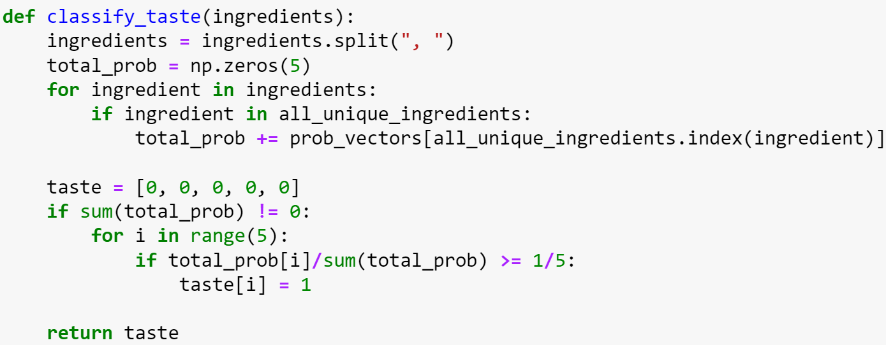
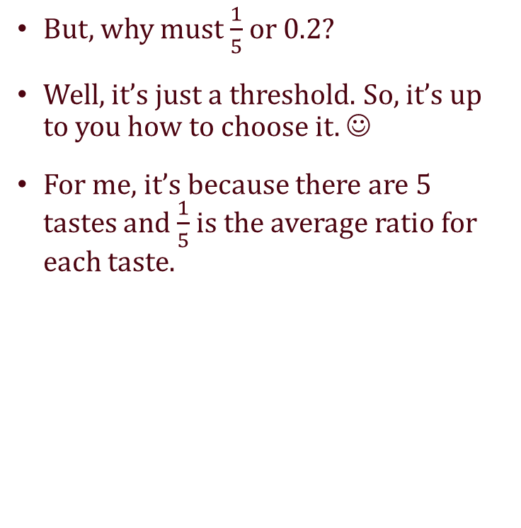
How to classify food taste?
But, why must $\frac{1}{5}$ or 0.2?
Well, it’s just a threshold. So, it’s up to you how to choose it. ☺
For me, it’s because there are 5 tastes and $\frac{1}{5}$ is the average ratio for each taste.

Slide 32
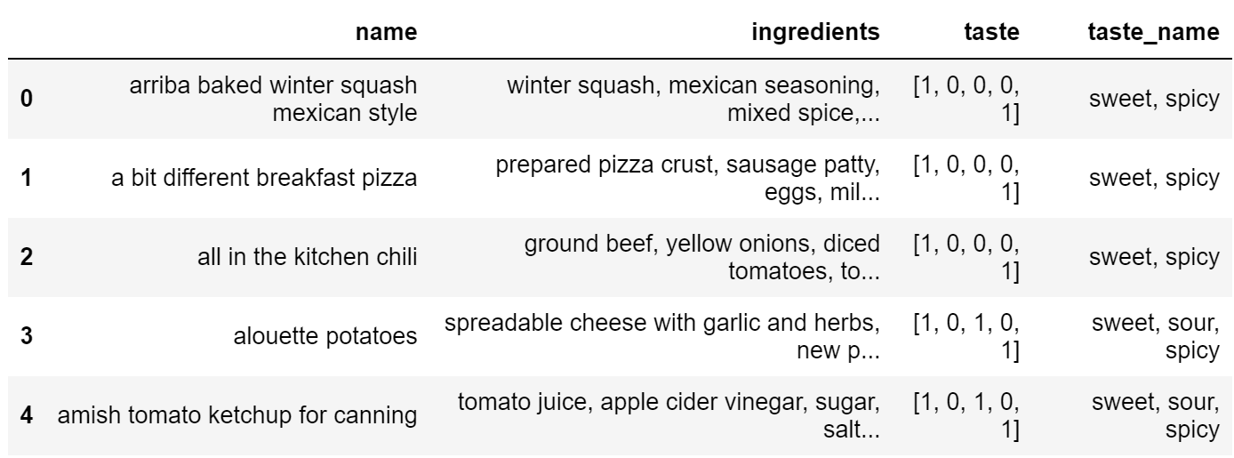
How to classify food taste?
Combine the labeled data and the “labeled” unlabeled data, and voila! We get a new large dataset!
Then, we can use this new dataset to recommend the food based on user’s currently preference taste. ☺

Slide 33
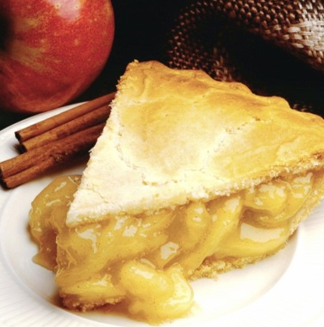
How to recommend the food?

Slide 34

How to recommend the food?
Well, it’s not that hard, so don’t worry.
We only use dot product.
First, we accept the user’s query.
Next, we find what tastes they want.
For example, user says “I want to something sweet and spicy!!!”.
We can represent that sentence into vector, i.e. [1 0 0 0 1].
Then, we can calculate the dot product of user’s vector representation and all of the food taste’s vector representation.
The higher result will be shown to the user.

Slide 35
How to recommend the food?
Wait! What if the user says “I want to eat something sweet, but not spicy!!!”? Or what if the user says “I want to eat something sweet, but a little sour.”?
Well, I’m sorry to say that it’s this recommender weakness.
It only detect the taste appear on the user’s query.
That means, “not spicy” will be interpreted as “spicy”.
Maybe next time I will improve it. It will be better if you give me the idea. ☺

Slide 36
How to deploy our food recommender?

Slide 37
How to deploy our food recommender?
This is my first time to deploy my creation to a web service, so this might look amateur for you. XD
I chose Streamlit to deploy this food recommender, thanks to this tutorial.
Using Streamlit is the easiest and faster way to deploy our data apps.
Just upload the code on Github, create an account on Streamlit, then connect the Github repository to the Streamlit.
The detail explanation on how to do it can be read on the tutorial and my code on Github.

Slide 38
What are this recommender’s weaknesses?

Slide 39
What are this recommender’s weaknesses?
I’m pretty sure that there are still so many weaknesses since this is a very simple food recommender.
You might have noticed it, but I didn’t check the accuracy of the model.
Why? Because we don’t even know whether our first labelling method is correct. We only depend on the food’s title. It will effect our model of course.

Slide 40
What are this recommender’s weaknesses?
Next, it doesn’t know the difference between “not spicy” and “spicy”. Like I said before, the recommender will recognize “not spicy” as “spicy”.
It’s also case sensitive. A little typo won’t make the recommender work properly.
For those problem, we need to use NLP. But..maybe next time. ☺

Slide 41
What are this recommender’s weaknesses?
I must say that the information given by the recommender is not that informative. Just giving the name of the food and ingredients won’t help. It will be better of we mention the link to the Food.com.
But the problem is, I don’t know how to do it. XD
We can also use fuzzy logic to define the level of each taste, so user can say something like “I want to eat something sweet, but not too sour and spicy”.

Slide 42
Well, I think that’s all from me. I hope it will inspire many people to create something great. Don’t hesitate to ask, comment, or give any suggestion to me.
Thank you. ☺

